Slide 1

Senior Design
https://github.com/powermad80/web-rubric

Slide 2


Group Member Information
Team
Hannah Dubusker (CS) – hannahdubusker@gmail.com
Rohan Kapoor (CS) – kapoorrn@mail.uc.edu
Advisor
Dr. Xuefu(Frank) Zhou – zhoxu@ucmail.uc.edu

Slide 3

Project Abstract
Web application that will present the instructor with a UI to grade a UC student’s senior design project.
Instructor/Student can access the application using their UC 6+2 credentials
Students can upload senior design project and review their grades
Instructor can import, save and modify rubric as well as grade student’s projects

Slide 4
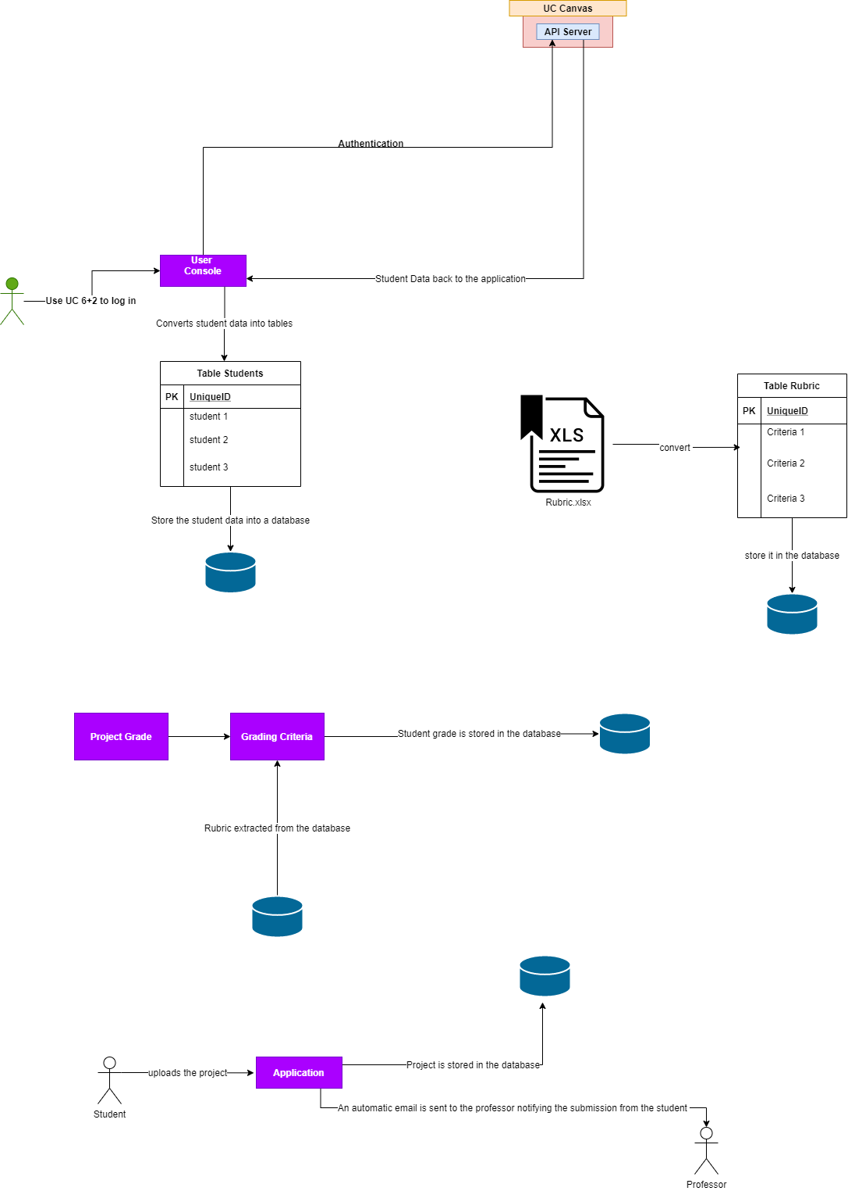
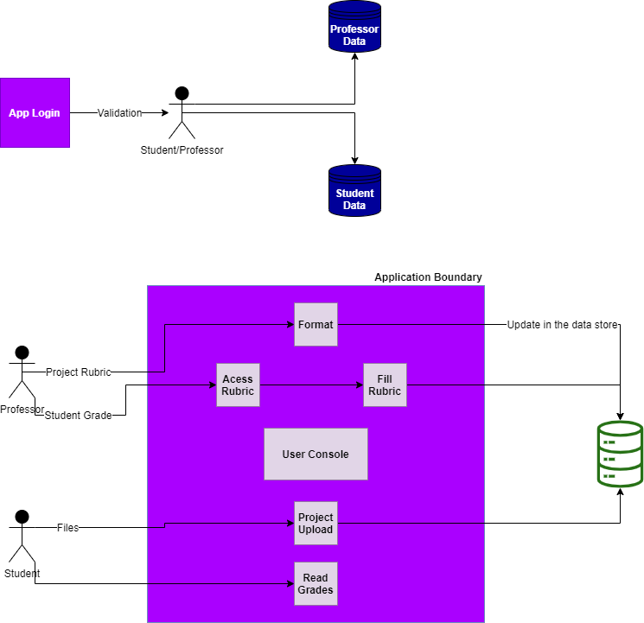
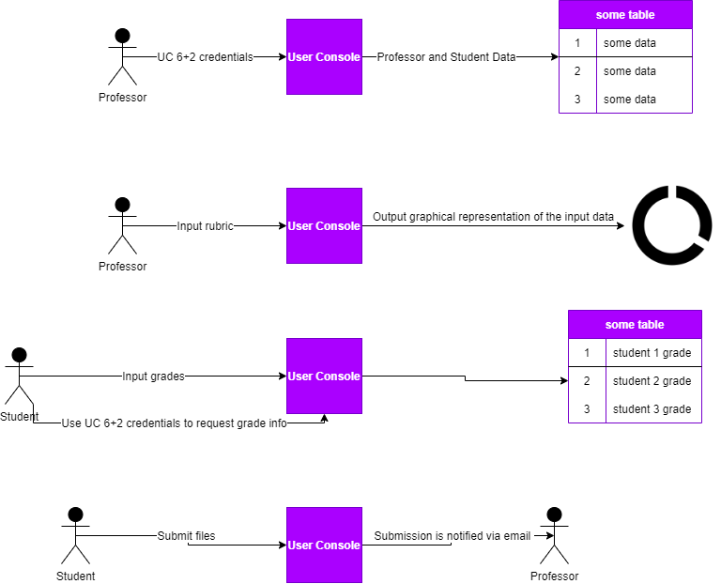
Design Diagrams

Slide 5

User Stories
As a professor, I want to upload my student lists to the website so that I can easily manage info related to them and their projects.
As a professor, I want to log into the website from any computer and see the info pertaining to my class and students, so that I can securely manage their info.
As a professor, I want to upload my project rubric to the website so that I can interact with and make changes to it.
As a professor, I want to fill out and assign scores based on the rubric I have uploaded to students, based on the criteria in the rubric.
As a student, I want to log into the website from any computer and see the info pertaining to myself and my group (if applicable) so that I can manage my assignments and grades, if given.
As a student, I want to upload my project and any related notes to the website so that submitted materials are clear and accessible to the professor
As a student, I want to be able to view my graded rubric for a given project submission, to review and learn from how my work was judged.

Slide 6

Project Constraints
Economic Cost
While the project can be built entirely with free and open source tools, frameworks, and libraries, the nature of designing a web application means eventually the cost of server hosting will arise. This may not necessarily be a large expense depending on use and traffic to the web app, but it is one that exists.
Scope
There is some room for argument among our group and advisor on the exact scope of this project, how far tools should extend to professors and students.
Professional/Technical
Members of our group may be confident in their abilities, but every major project contains its unexpected challenges, and it is possible that significant challenges may arise in technical implementation of concepts agreed to be within the scope of the project.
Security
As this web application handles student and professor info regarding class details, project submissions, and grading, security concerns must be taken into account. Secure authentication and storage of sensitive data must be handled with great care and within modern standards.

Slide 7
Division of Work
Project is divided into 8 tasks
Each task will be worked on a defined time frame with varying contributions from the team members.
Timeline
Task | Contributor(s) | Start Date | End Date
Functional Login Page | Dubusker & Kapoor | 6-Jan-21 | 15-Jan-21
Professor landing page | Dubusker | 15-Jan-21 | 22-Jan-21
Rubric Upload and View | Dubusker & Kapoor | 22-Jan-21 | 31-Jan-21
Rubric Edit | Dubusker & Kapoor | 31-Jan-21 | 14-Feb-21
Rubric from-fill | Dubusker & Kapoor | 21-Feb-21 | 28-Feb-21
Student landing page | Dubusker | 28-Feb-21 | 7-Mar-21
Student project upload | Dubusker & Kapoor | 7-Mar-21 | 14-Mar-21
Student grade and feedback | Dubusker & Kapoor | 14-Mar-21 | 21-Mar-21

Slide 8

Review of Project Progress

Slide 9
Expected Accomplishments (Fall 2020)

Slide 10

Demo at Expo

